Slide 1

MGM Institute of Physiotherapy
Aurangabad
MAHATMA GANDHI MISSION
Didactic Lecture

Slide 2



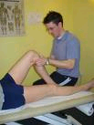
Introduction to Musculoskeletal/
Orthopedic Assessment
Dr. surendra Wani
Dept. Of Musculoskeletal Physiotherapy
MGM Institute Of Physiotherapy
Chh. Sambhajinagar

Slide 3
Learning Objectives
At the end of the lecture, the student should be able to:
  Determine the principles and concepts of a musculoskeletal assessment
  Identify cues and information that needs to be obtained in a subjective musculoskeletal assessment
  Formulate hypothesis of the problems assessed and determine examination procedures that may confirm or refute a hypothesis

Slide 4
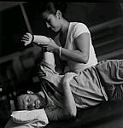
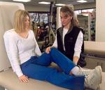

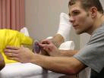
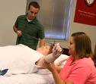
Objective Assessment
Inspection
Palpation
Sensory examination
Range of Motion
Joint play
Muscle Performance/Motor control/resisted iso.
Dermatomes,myotomes
Posture, Gait, locomotion, and balance
Special Tests
Anthropometric measurements
Functional assessment
Environmental assessment

Slide 5


OCULAR INSPECTION
Manner of arrival
  Ambulatory: independent or with device or dependent on caregiver for mobility
  Facial expression: apprehensive, restless, depressed, in discomfort
Body type
  Ectomorph, endomorph, mesomorph
Level of consciousness
Attachments: cast,
fixation devices,
dressings
Swelling
Trophic skin
changes
Atrophy
Gross
deformities
Notes:
Are the bony contours of the body normal and symmetric or is there an obvious deviation?
Are the soft tissue contours normal and symmetric? Note the presence of muscle wasting.
Are the limb positions equal and symmetric?
Are the color and texture of the skin normal? Does the appearance of the skin differ in the area of pain or symptoms compared to other areas? Note any signs of bruising or discoloration, shiny skin, hairloss, skin breakdown, or brittle/ridged nails.
Is there a scar that may indicate injury or recent surgery?

Slide 6
Observation
Posture
Deformity (structural or dynamic): restricted ROM, malalignment, bone shape alteration or joint deformity
Bony contours normal and symmetric
Soft tissue contours normal and symmetric
Color and texture of the skin
Any scars, signs of inflammation
Patient’s facial expression and comfort

Slide 7
Skin conditions | Implications
Loss of skin elasticity, shiny, hair loss, breakdown and healing, nails brittle and hard | Peripheral nerve lesions
cyanosis | Poor blood perfusion
Redness | Inflammation

Slide 8
Examination principles
Normal side assessed first
Active movements before passive and then RIMs
Myotonal weakness takes time to develop, so sustain contraction for at least 5secs
Movements that are painful done last
Passive ROM: degree and quality both imp
RIMs: done in Mid range, to differentiate contractile vs noncontractile tissues.
Joint end feel: do not exacerbate symptoms
Ligamentous tests: stress applied gently and several times and increased stress but not beyond the point of pain. Thus, maximum instability demonstrated with no muscle spasm
Note for vascular insufficiencies
Relax the patient

Slide 9

PALPATION
The therapist should take note of the following:
Tenderness
Swelling
Variations in temperature
Muscle spasm
Differences in tissue texture
Abnormal sensation
Grading of tenderness
Grade I: pt complains of pain
Grade II: pt complains of pain and winces
Grade III: pt winces and withdraws the part
Grade IV: pt does not allow palpation
Swelling
Bony/hard: osteophyte formation
Boggy, spongy: synovial
Soft, pliable, fluctuating: fluid
Hard, thick, gel-like, warm: blood
Thick, non-fluctuating, warm: pus
Tough, dry, leathery:callus
Thick, slow moving, indentation after pressure: pitting edema
Abnormal Sensation
Dysesthesia: diminished sensation
Hyperesthesia: increased sensation
Anesthesia: absence of sensation
Crepitus: grating, creaking upon movement of a limb usually in the joint or tendinous unit

Slide 10
Scar – Adherent / Non Adherent

Slide 11
Deep Tendon (Stretch) Reflexes
Comparison of both sides is very important.
A patient may present with symmetrically decreased reflexes and be perfectly normal
Hyperreflexia - upper motor neuron disease secondary to decreased inhibition by the motor cortex
Hyporeflexia - lower motor neuron disease may be the causative factor secondary to an interruption n the reflex arc
0: absent reflex
1⁺: trace, or seen only with reinforcement
2⁺: normal
3⁺: brisk
4⁺: nonsustained clonus (i.e., repetitive vibratory movements)
5⁺: sustained clonus

Slide 12


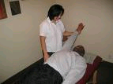
RANGE OF MOTION ASSESSMENT
Observe / palpate the movement of the other joints
Ask the patient to perform the painful movement as a baseline for your assessment
Watch out for trick movements
Check the end-feel

Slide 13

Range of Motion:
Active ROM
The therapist should note the following:
When and where during the movement onset of pain occurs
Whether the movement – painful/painless
Patient reaction
Amount of restriction
Pattern of movement
Quality of movement
Movement of associated joints
Willingness of the patient to move the segment

Slide 14

Range of Motion:
Passive ROM
The therapist should note the following:
When and where during movement the pain begins
Whether the movement increases the intensity and quality of pain
Pattern of limitation of movement
  Capsular or non-capsular
End feel of movement
Movement of associated joints
Range of motion available
Notes:
Capsular: characteristic pattern of limitation when the joint capsule is affected

Slide 15
End feels
Normal –
Bone to Bone –
Soft Tissue Approximation
- Tissue Stretch
Abnormal –
Early Muscle Spasm –
Late Muscle Spasm –
Hard Capsular - Soft Capsular –
Bone to Bone - Empty - Springy Block

Slide 16
CAPSULAR PATTERN
Seen when entire capsule is shortened
Manifests itself as a characteristic pattern of decreased ROM at a joint
Follows the sequence of descending decreased ROM
E.g - shoulder- ER, abduction, IR

Slide 17
Assessment of joint play
Moving the articular surfaces
Direction of movement during assessment is either PARALLEL or PERPENDICULAR to the treatment plane
Distraction joint play assessment
Gliding joint play assessment

Slide 18
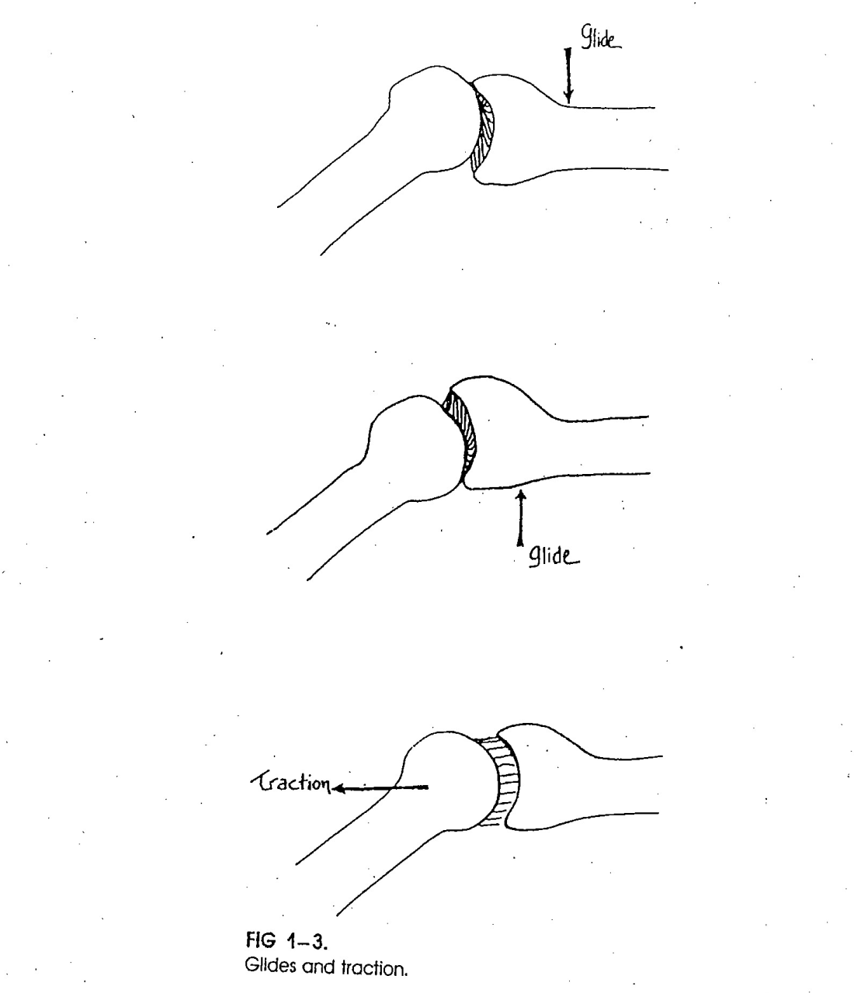
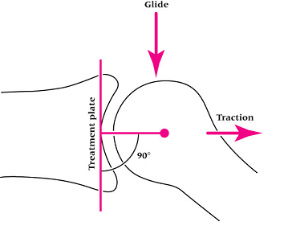

Slide 19
The therapist should take into consideration the following:
  Patient should be relaxed and fully supported
  Use firm and comfortable grasp
  Examine one joint and movement at a time
  Test the unaffected side first
  As one surface is moved, the other is stabilized
  Movements should not be forced
  Movements should not cause discomfort
  Loose packed position

Slide 20
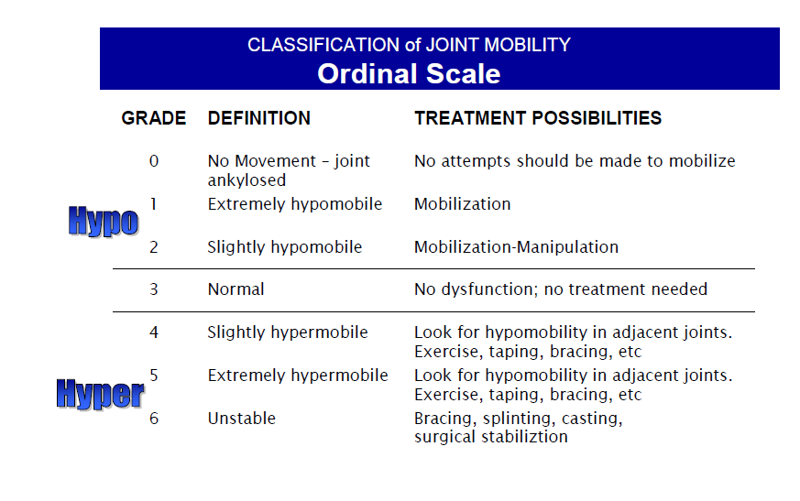

Slide 21
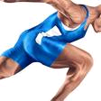
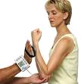


MUSCLE PERFORMANCE
The therapist should assess various components of muscle performance (if appropriate):
  Strength
  Muscular endurance
  Power
Use of manual muscle test (MMT,fitness testing tools to determine baseline function of individual muscles or groups of muscles

Slide 22
Grades
Normal (5): The muscle can withstand a strong degree of resistance against gravity.
Good (4): The muscle can withstand a moderate degree of resistance against gravity.
Fair (3): The muscle is able to sustain the test position against gravity.
Poor (2): The muscle is able to complete the range of motion in a plane that is parallel to gravity (gravity eliminated).
Trace (1): The muscle can perform a palpable contraction but without any visible movement.
Zero (0): No contraction is present

Slide 23
Resisted Movement Testing
Resisted movement testing involves an isometric contraction of the muscle that is performed in the neutral (mid) position.
The joint must be held still so that the amount of stress placed on the inert (noncontractile) structures is minimized
Resisted testing will help isolate the musculotendinous unit as the cause of the pain.

Slide 24
1. Strong and painful -an injury to some part of the muscle or tendon.
2. Weak and painless -a full rupture of the muscle or may imply an interruption of the nervous innervation of the
muscle.
3. Weak and painful - gross lesion such as a fracture or metastatic lesion.
4. Strong and painless responses are indicative of
normal structures.

Slide 25

POSTURE
Provides information as to the probable cause of the deformity
The therapist should note the following:
  Difference in alignment of the body segments: asymmetry
  Presence of upper/lower crossed syndromes
Guidelines:
  Patient appropriately undressed
  No shoes, socks, stockings
  Note use of walking aids, braces, etc.
  Examine in the habitual, relaxed
  posture
  Assess in standing, sitting, and lying
  positions
Weak lengthened phasic muscles
Tight hypertonic postural muscle
JOINT
Weak lengthened phasic muscles
Tight hypertonic postural muscle
Notes:
Aids
* Ask patient to not use it for assessment of natural state then assess with the aid to compare the effects of using the device

Slide 26
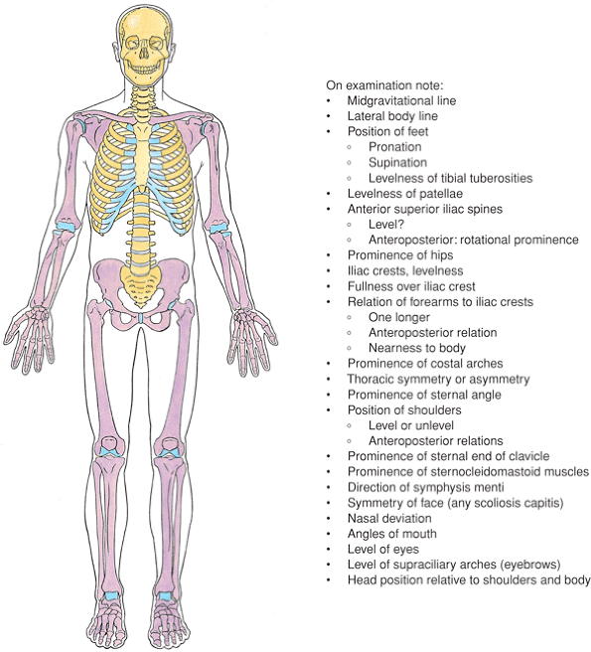

Slide 27
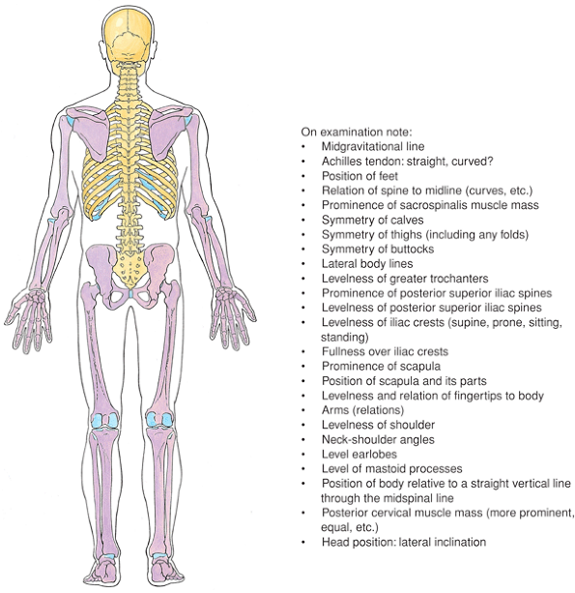

Slide 28
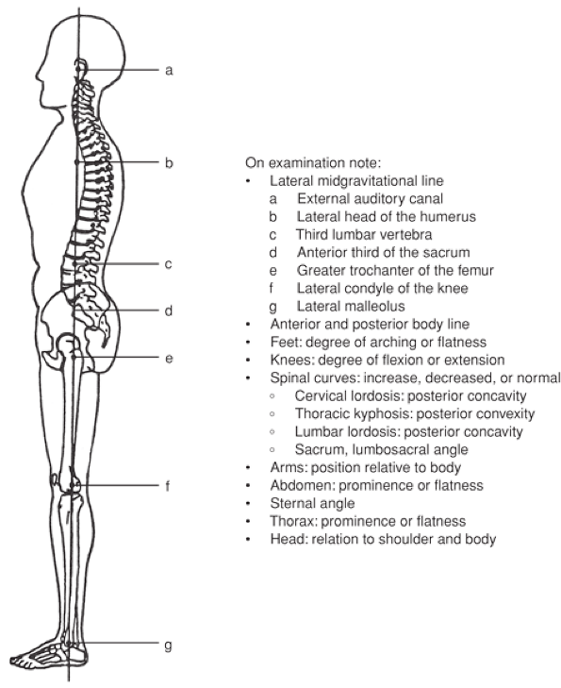

Slide 29
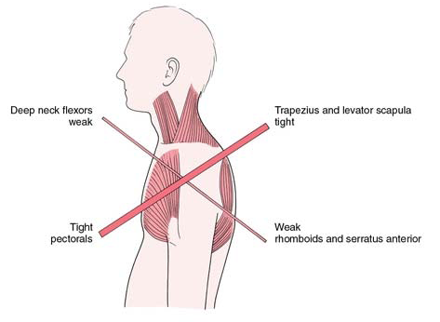

Slide 30
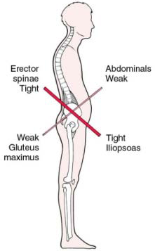

Slide 31
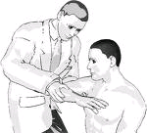
SPECIAL TESTS
Allows the therapist to:
  Confirm a tentative diagnosis
  Make a differential diagnosis
  Differentiate between structures
  Understand unusual signs
  Unravel difficult signs and symptoms
Some tests have poor reliability and validity therefore the therapist should use these with caution
Findings depend on the skill and ability of the examiner to perform and identify (+) and (-) signs

Slide 32

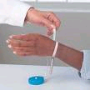

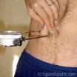
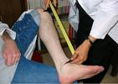
ANTHROPOMETRIC MEASUREMENTS
Helps in formulation of a diagnosis/impression regarding the patient’s condition (leg length discrepancy), in prognosis (swelling), and in identifying the patient’s body type (skinfold measurement)
Performed in the presence of:
  Swelling
  Asymmetry in limb girth
  Postural and gait deviations
  Amputation

Slide 33


GAIT, LOCOMOTION ASSESSMENT
Majority of gait assessment is observation
The therapist should take note of the following:
  Presence of gait deviations: abnormal gait patterns
  Difference between the right and left lower extremity during specific cycles/phases of gait
  Compensatory mechanisms
  Speed and cadence of walking
Guidelines:
  The patient should be assessed both in normal footwear and in bare feet
  Take time to observe the patient during gait assessment
  Assess in the anterior, posterior and lateral views
  Note use of gait aids, etc.

Slide 34
FUNCTIONAL ASSESSMENT
Uses of functional assessment:
  Helps the therapist establish what is important to the patient and the patient’s expectations
  Represents a measurement of a whole-body task performance ability
  Determines the effect of injury to the patient’s daily functions/activities
May involve task analysis, use of various functional assessment tools, fitness profiles

Slide 35

ENVIRONMENTAL ASSESSMENT
Home or workplace assessment provides the therapist information regarding the influence of the patient’s environment to the present condition
  Are there any barriers to normal movement that predispose the patient to certain conditions?
  Are modifications necessary to allow proper performance of activities?

Slide 36

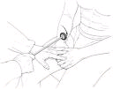
NEUROLOGIC ASSESSMENT
Performed in certain conditions that involve neurologic structures
  Nerve lesions: peripheral nerve injuries
Provides baseline information regarding the integrity of the patient’s neural structures
The therapist assesses the following:
  Sensation
  Deep tendon reflexes

Slide 37
Summary & Questions
End feels and its types
Capsular and non capsular pattern.
Joint mobility assessment
Joint play

Slide 38
QUESTIONS???
THANK YOU
FOR
LISTENING!

Slide 39
REFERENCES
Hertling, D. and Kessler, R. (1990). Management of common musculoskeletal disorders: Physical therapy principles and methods (2nd ed.). San Francisco: J. B. Lippincott Company.
Loudon, J., Bell, S., and Johnstin, J. (1998). The clinical orthopedic assessment guide. USA: Human Kinetics.
Magee, D. (2002). Orthopedic physical assessment (4th ed.). Singapore: Elsevier Sciences.
Refshauge, K. and Gass, E. (1995). Musculoskeletal physiotherapy: Clinical science and practice. London: Butterworth-Heinemann Ltd.
Starkey, C. and Ryan, J. (1996). Evaluation of orthopedic and athletic injuries. USA: F. A. Davis Company.

